Slide 1
Civil Engineering Project
James Zartman
METC-107
Fall 2017

Slide 2
Area
The total area of the overall lot size was 1,1025,636.18 sq. ft.
The total area of my proposed pavement size is 921,847 sq. ft.
  Difference of 103,789.18 sq. ft.
    That is an extra 720 standard parking spots
Theoretically the total maximum number of standard parking spots for the proposed pavement size is 6401 parking spots
  My total number of spots is 2964 parking spots including handicap spots
    2906 - standard
    58 - handicap

Slide 3
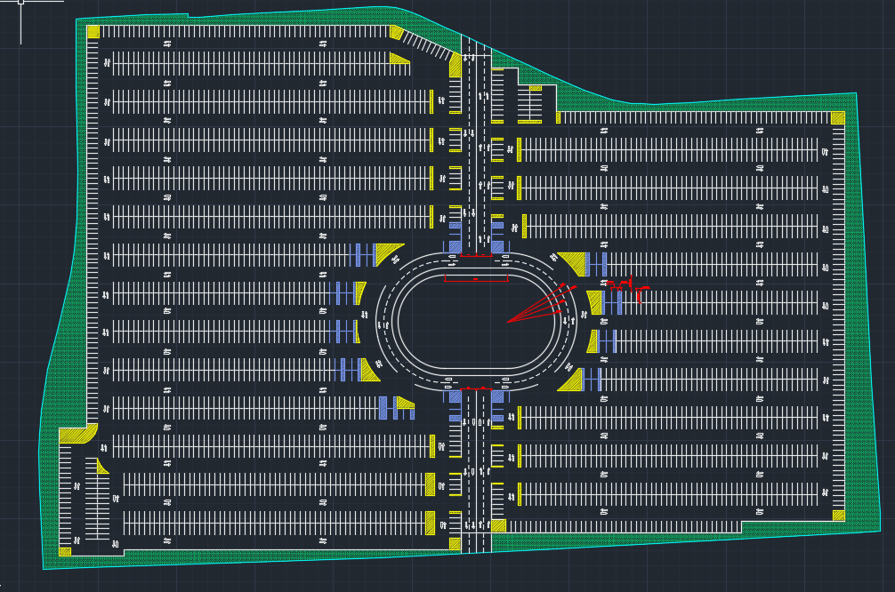
Layout

Slide 4
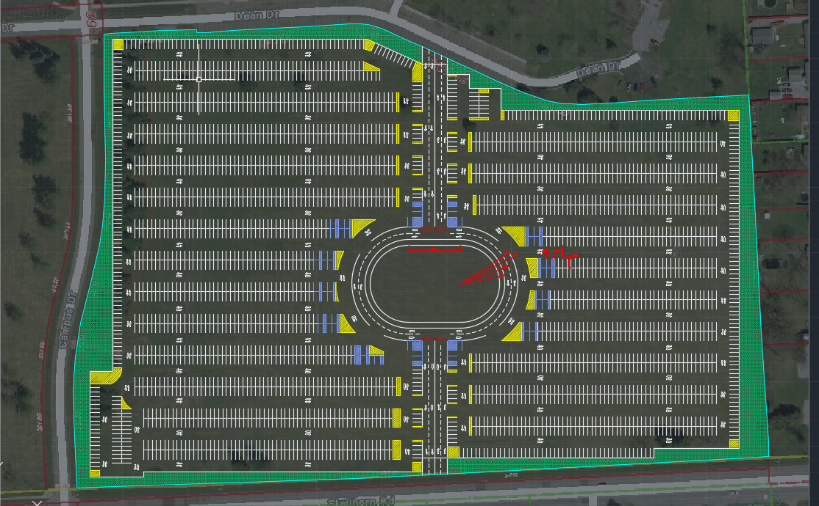
Layout Cont.

Slide 5
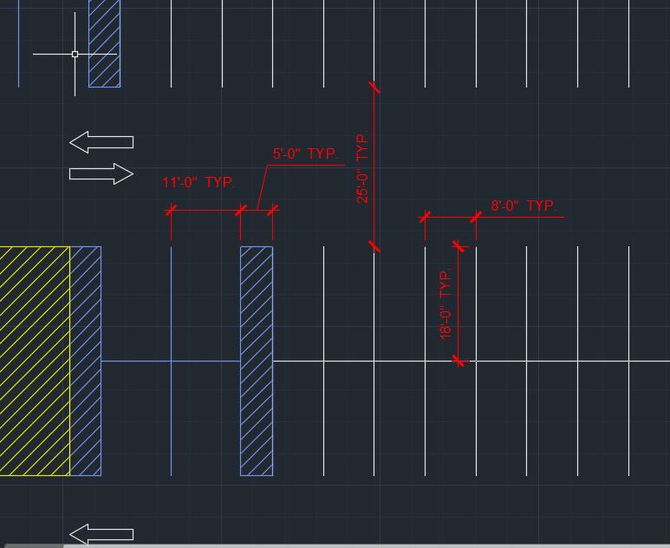
Layout

Slide 6
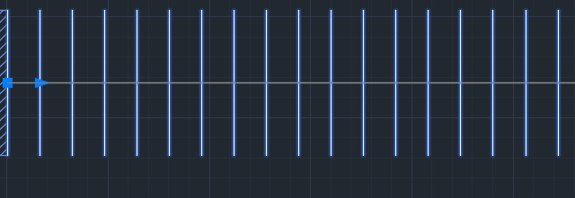
Methods used
Array Command
Hatching
Copy and paste
Rotate
CAD blocks
Poly line
3- point arc
Mirror command

Slide 7
Advantages
The arena is close to the middle of the parking lot
  Not as far of a walk
Top half and bottom half can exit the parking lot respectively
2 access points to the parking lot
Can drive all the way around the arena
  Plenty of spots for curbside drop offs

Slide 8
Disadvantages
There are some areas where the layout of the parking lot could be more difficult to maneuver.
I think that having angled parking spots could yield more spots with current layout
  Aisle ways then become one way (or should be) but didn’t have enough confidence that people would drive the right way so made all aisle ways two way
No shuttle stops…

Slide 9
Reason for choosing access point
2 is better than 1
Had one enter and exit from dean drive and Stelhorn
  Get rid of campus Drive
    Forces people to exit on dean drive to St. Joe
  Put light in at Stelhorn entrance and exit
Top and bottom
  Midpoints of lot

Slide 10
Sources
http://qcode.us/codes/temecula/view.php?topic=17-17_24-17_24_050
https://www.access-board.gov/guidelines-and-standards/buildings-and-sites/about-the-ada-standards/background/adaag#4.1
www.acimap.us/engineering.html

